Slide 1

LatentView Proposal – ETL Capabilities
Aug 2018

Slide 2
Agenda
1
About LatentView
2
Our ETL Capabilities
3
Case Studies
4
Effort Estimation

Slide 3
About LatentView

Slide 4


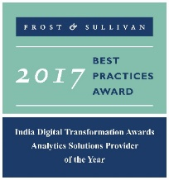




LatentView – A World Class Analytics Company
Awards & Recognition
Founded in
Over
Grown
Work with
Strong Performer - Customer Analytics Services, 2017
600
11
30+
2006
People strong
times in last
six years
Fortune 500
firms
Repeat business at
Member of
2009-2017
Technology council
Rated as Top
10
5%
4/5
>85%
Repeat
business
Analytics companies to work for in India
Re-investment in Research and Development
Top technology companies engage with us

Slide 5
Cutting Edge Solutions in Advanced Analytics
Hindsight – What happened?
Insight – Why did it happen?
Foresight – What should we do?
Data Acquisition
Acquiring the data from both traditional, big data and other digital sources.
Data Processing
Data preparation for analysis and insights, using internal, external, batch, streaming, structured, unstructured data. (On-premise and cloud based techs)
Reporting & Visualization
Creating dashboards and reports for a business-focused audience
Graph Analysis
Better exploration of frequency, strength and direction of relationships
Exploratory Analysis
Experience in gaining deep insights from unstructured and structured data traditional methods
Natural Language Processing
Extract entities, tag PoS, extract relationships, analyze sentiments
Real Time Analytics
Better exploration of frequency, strength and direction of relationships
Deep Learning
Experience in analysing connection data for clustering/ causality
Machine Learning
Deep experience with various machine learning algorithms, including Ensemble Learning, Neural Networks, etc.

Slide 6
Our ETL Capabilities

Slide 7




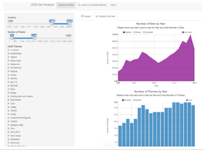











Our ETL Capabilities
Business Objective
Business Needs
To build complex data layers for BI Self Service team to cater to the ad-hoc reporting requests received via service tiers 1,2,3 types
To help the Walmart GPA team by increasing their Analytics capabilities through Data Modeling and User Training
To prepare a Data Layer and build a visually interactive application using R Shiny apps.
Extract
Transform
Load
Methodology
ETL Process
The process of extracting the data from Multiple sources
Transform the extracted data to required format
Load the transformed data to a common destination
Data Sources
Data Validation
Data Cleansing
Data Processing
Data Mart
R Shiny App
Business
Users
Senior Management
Hosted on cloud
Pros of R Shiny
Limitations of R Shiny
Efficient Response Time
Restriction of Traffic in Free Version
Complete Automation of the App
Requires Timely Updates (upgrading packages)
Advanced Visualization Capabilities
Cost Effective

Slide 8
Case Studies

Slide 9
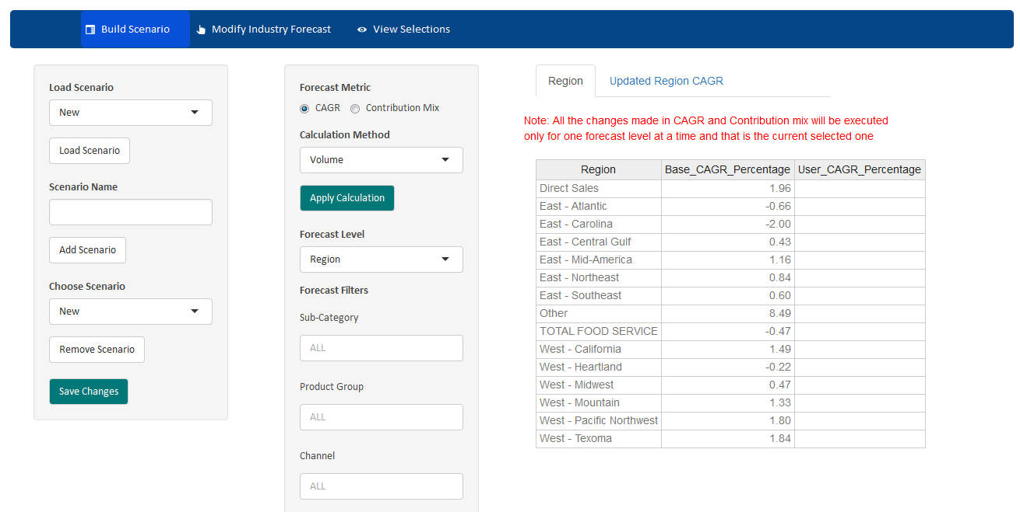
Planner Tool : Leading Global Food & Beverages Corporation
To predict the future revenue and sales using the user's input of various factors such as inflation, population growth & more

Slide 10
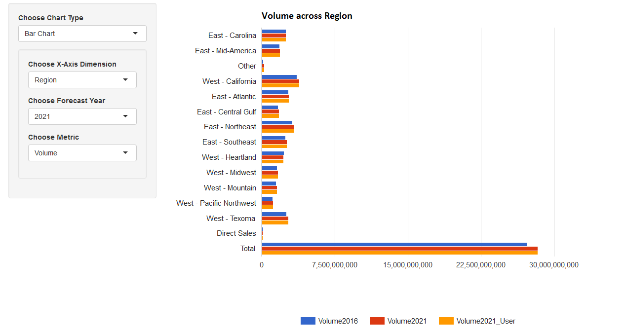
Planner Tool : Leading Global Food & Beverages Corporation
To predict the future revenue and sales using the user's input of various factors such as inflation, population growth & more

Slide 11
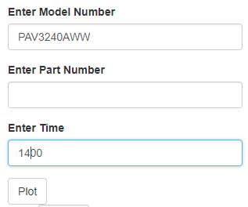
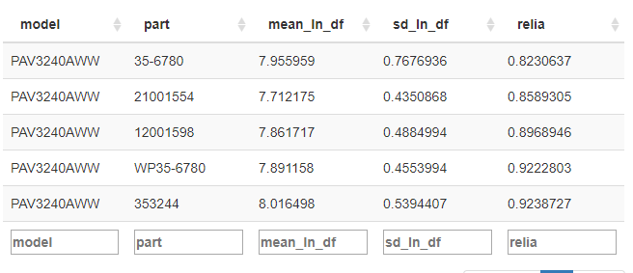
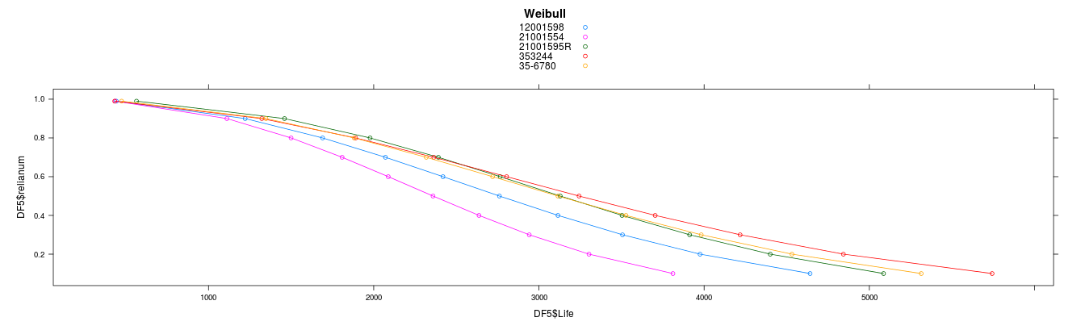
Reliability Tool : Leading Home Appliances and Repair Services Provider
Understand the reliability of parts through part failure data & To Proactively manage spare parts
This is the table showing Top 5 parts with reliability values

Slide 12
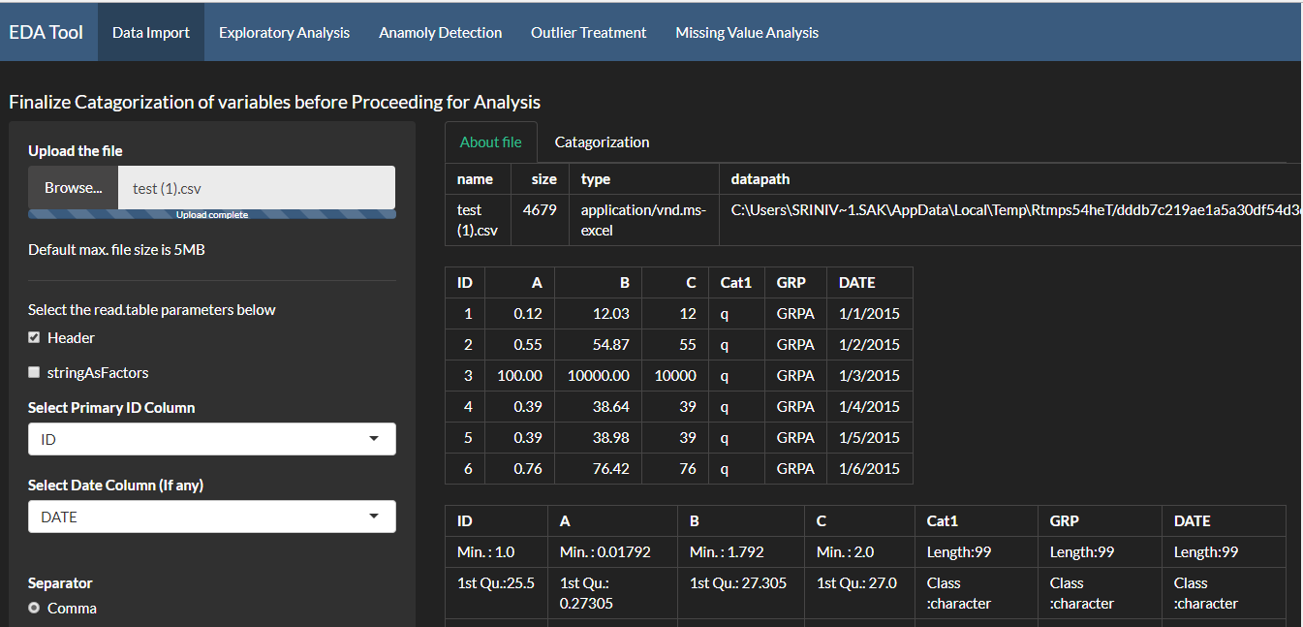
Exploratory Data Analysis Tool : A Leading Asset Management Company
To deep dive on any given data set and understand the Anomalies & Outliers

Slide 13
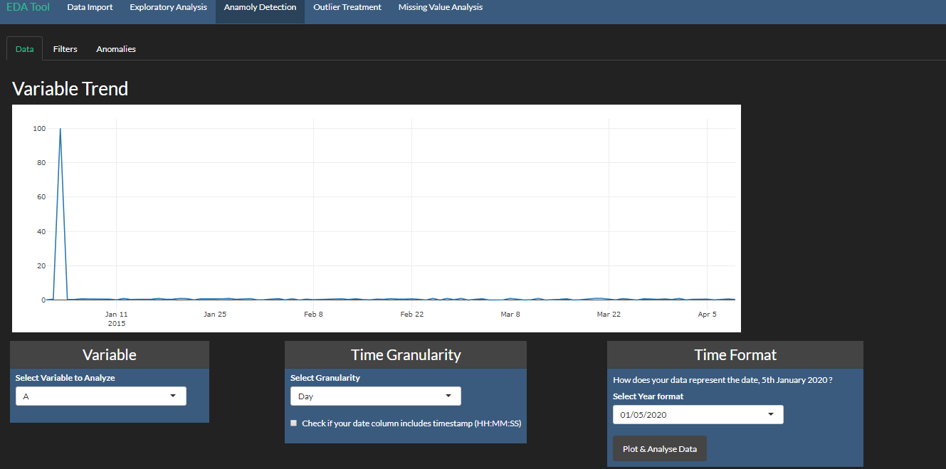
Exploratory Data Analysis Tool : A Leading Asset Management Company
To get the trend of a given variable / KPI

Slide 14
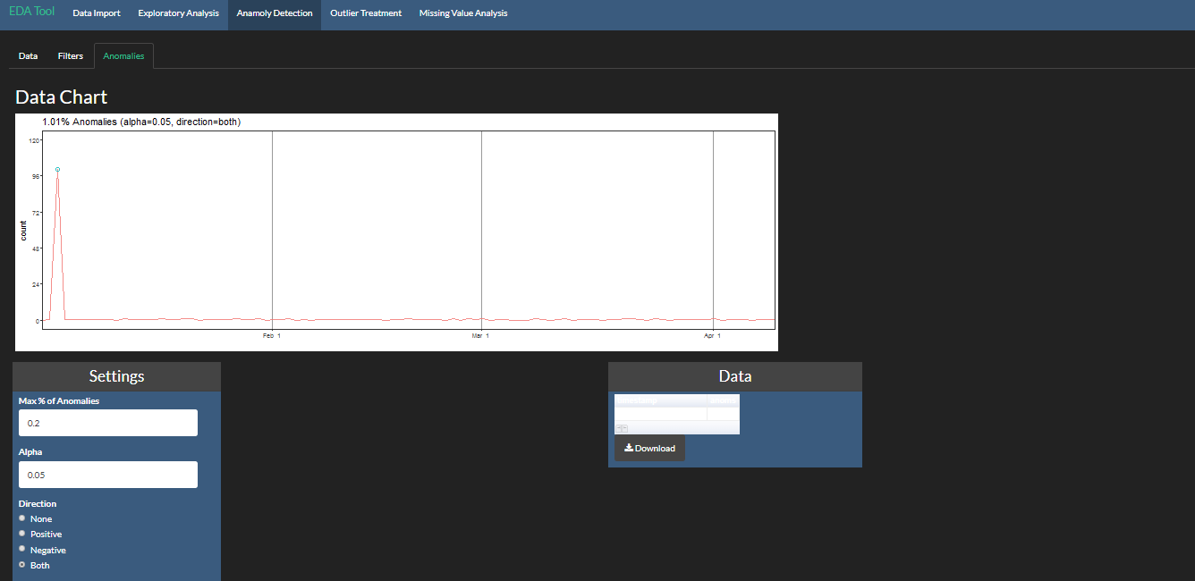
Exploratory Data Analysis Tool : A Leading Asset Management Company
To find the anomalies in the dataset

Slide 15
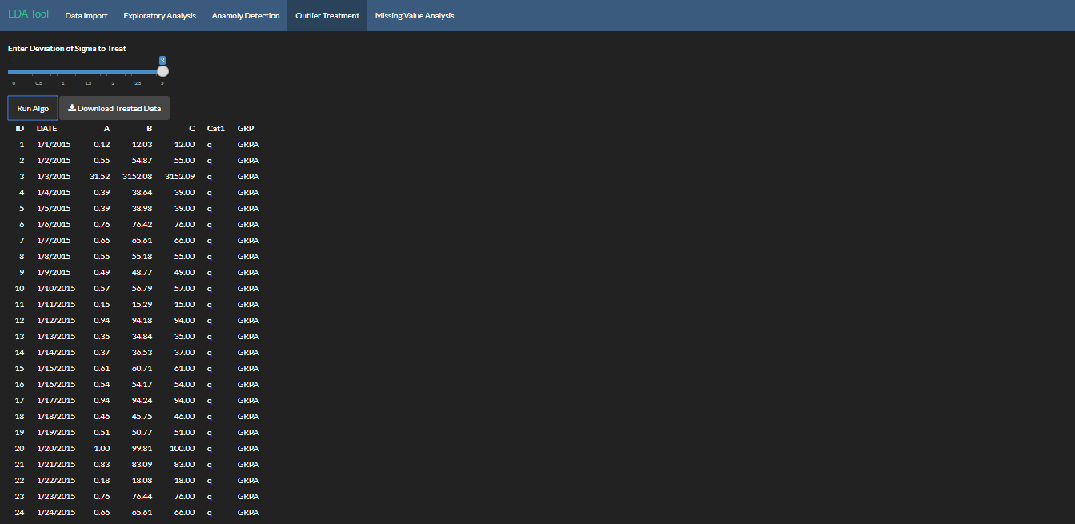
Exploratory Data Analysis Tool : A Leading Asset Management Company
To make modifications to the dataset based on the outliers found and to fetch the treated data

Slide 16
Effort Estimation

Slide 17








Effort Estimation & Governance Structure
Resources
1 Onsite Resource
2 Offshore Resources
Time Period
3 Months
Pricing
$XXX USD
Note
Agile methodology is to be adopted for this engagement
Additional resources & time duration will be accounted based on the preferred list of analysis
Client
LATENTVIEW ONSHORE TEAM
LATENTVIEW OFFSHORE TEAM
CLIENT PROGRAM
MANAGER
ENGAGEMENT MANAGER
PROJECT MANAGER
CLIENT TEAM
TEAM LEADS
DATA
ANALYSTS
TABLEAU
EXPERTS

Slide 18
Thank You
amritsagar.mohapatra@latentview.com

